Slide 1


Christopher Cable
April 12, 2023

Slide 2

Outline
Executive Summary
Introduction
Methodology
Results
Conclusion
Appendix

Slide 3
Executive Summary
In order to predict whether SpaceX would successfully land the first stage of their next launch, data was collected from <lab ½ souces> and Wikipedia about SpaceX’s previous launches. Exploratory data analysis was performed using various data visualization techniques to identity related variables that had a strong correlation with the success or failure of the first stage landing. Using these insights, target features were identified and used to compile a cleaned dataset. This dataset was then used to train and test various machine learning models in order to establish which model was the most accurate at predicting the success of SpaceX’s landing attempts. It was determined that a decision tree classifier was most appropriate for this task.

Slide 4
Introduction
The industry of commercial space launches is a highly competitive emerging field. While the typical cost of a commercial space launch can be upwards of $165 million, SpaceX (a leading competitor in this field) offers space launches using its Falcon 9 rocket at a price as low as $65 million. These cost savings come from SpaceX’s ability to land and reuse the first stage of their Falcon 9 rockets. Therefore, in order to determine the appropriate contract bid when competing against SpaceX for a commercial launch, we must first predict if SpaceX will land and reuse their launch vehicle. We will accomplish this by creating a predictive model trained on publicly available data from SpaceX’s previous missions.

Slide 5

Section 1

Slide 6
Methodology
Executive Summary
Data collection methodology:
Data was collected using both the SpaceX API and webscraping techniques to pull data from SpaceX’s own publicly available data and from online articles.
Perform data wrangling
Describe how data was processed
Perform exploratory data analysis (EDA) using visualization and SQL
Perform interactive visual analytics using Folium and Plotly Dash
Perform predictive analysis using classification models
How to build, tune, evaluate classification models

Slide 7
Data Collection
During the data collection phase, public data was pulled both directly from SpaceX and from web articles cataloging their previous launch history. Using both an official SpaceX API, as well as basic web scraping techniques, the raw data was gathered into two starting dataframes, before being processed and refined for use in predictive models.

Slide 8
Data Collection – SpaceX API
Using a .get() request, the SpaceX API was called to retrieve data from the SpaceX online database in JSON format. It was then normalized and converted into a dataframe.
API = “https://api.spacexdata.com/v4/launches/past”
GitHub URL: https://github.com/cbcable/Capstone-Project/blob/e0b9cd2fce0e67726b59ea319e1d7796970ead66/Part%201%20Data%20Collection%20API%20Lab.ipynb
Place your flowchart of SpaceX API calls here

Slide 9
Data Collection - Scraping
Using BeautifulSoup, data was scraped from the Wikipedia page covering the Falcon 9 and Falcon Heavy launches in tabular format.
https://github.com/cbcable/Capstone-Project/blob/6afe218e19f8fc4fe62dde2ad6eb893e8d9ce435/Part%202_%20Data%20Webscraping.ipynb
Place your flowchart of web scraping here

Slide 10
Data Wrangling
The first step in processing the data was to check for null values and determine the data types of each column. We then explore the occurrence counts of various features, such as orbit type and total successful landing outcomes. We then create an array of unsuccessful landing outcomes, which we use to check against the dataframe using a “for” loop to create a list of binary values where a successful landing is equal to 1 and an unsuccessful landing is equal to 0. This list was then appended to the dataframe under the column key “Class”.

Slide 11
Data Wrangling
You need to present your data wrangling process using key phrases and flowcharts
https://github.com/cbcable/Capstone-Project/blob/6afe218e19f8fc4fe62dde2ad6eb893e8d9ce435/Part%203_%20Data%20Wrangling.ipynb

Slide 12
EDA with Data Visualization
Summarize what charts were plotted and why you used those charts
During the data visualization process, scatter plots and bar charts were employed to visualize relationships in the data. Scatter plots were used to visualize the correlation between launch site and flight number, between launch site and payload mass, and between payload mass and flight number. A bar chart was then used to display the average success rate for each orbit type, which revealed the top four orbit types with the most successful launches.
https://github.com/cbcable/Capstone-Project/blob/54c53aaf0a8ef75fd405b022b9597b5783af3564/Part%205_%20EDA%20with%20Pandas%20and%20Matplotlib.ipynb

Slide 13
EDA with SQL
SQL queries were used to explore the data. These queries were as follows:
Select distinct(LAUNCH_SITE) from CAPSTONE.SPACEX;
Select * from CAPSTONE.SPACEX where LAUNCH_SITE like ‘%CCA%’ limit 5;
Select sum(PAYLOAD_MASS__KG_) as TOTAL_PAYLOAD_MAS_KG from CAPSTONE.SPACEX where CAPSTONE.SPACEX.CUSTOMER like ‘%NASA (CRS)%’;
Select avg(PAYLOAD_MASS__KG_) as AVERAGE_MASS from CAPSTONE.SPACEX where CAPSTONE.SPACEX.BOOSTER_VERSION like ‘%F9 v1.1%’;
Add the GitHub URL of your completed EDA with SQL notebook, as an external reference and peer-review purpose

Slide 14
EDA with SQL
Select BOOSTER_VERSION, PAYLOAD_MASS__KG_, “Landing_Outcome” from CAPSTONE.SPACEX where “Landing_Outcome” like ‘%Success (drone ship)%’ and PAYLOAD_MASS__KG_ between 4000 and 6000;
Select count(MISSION_OUTCOME) as TOTAL_MISSIONS from CAPSTONE.SPACEX;
Select BOOSTER_VERSION from CAPSTONE.SPACEX where PAYLOAD_MASS__KG_ = (select max(PAYLOAD_MASS__KG_) from CAPSTONE.SPACEX);
Select BOOSTER_VERSION, LAUNCH_SITE, “Landing_Outcome”, DATE from CAPSTONE.SPACEX where “Landing_Outcome” like ‘%Failure (drone ship)%’ and DATE like ‘%2015%’;
Select distinct(“Landing_Outcome”) as OUTCOMES, count(“Landing_Outcome”) as NUM_OCCURENCES from CAPSTONE.SPACEX where DATE between ‘2010-06-04’ and ‘2017-03-20’;

Slide 15
EDA with SQL
GitHub Link
https://github.com/cbcable/Capstone-Project/blob/54c53aaf0a8ef75fd405b022b9597b5783af3564/Part%204_%20Exploratory%20Analysis%20Using%20SQL%20(1).ipynb

Slide 16
Build an Interactive Map with Folium
Using Folium, maps were generated to display the launch sites. Map markers were added to each launch site to show the successful and failed launches for each locations, which were then grouped into marker clusters. Next, the distance from one launch site to the nearest coast, town, highway, and rail line was calculated and displayed using a line. This created a simple-to-use interactive map that visualized the success rate of each launch site, its geographic location, and the relative distance from major landmarks. This allowed for a better understanding of the possible relationship between a launch site’s geographic location and proximity to various transportation resources, and its success rate.
https://github.com/cbcable/Capstone-Project/blob/54c53aaf0a8ef75fd405b022b9597b5783af3564/Part%206_%20Interactive%20Visual%20Analytics%20with%20Folium.ipynb

Slide 17
Build a Dashboard with Plotly Dash
Summarize what plots/graphs and interactions you have added to a dashboard
Explain why you added those plots and interactions
Add the GitHub URL of your completed Plotly Dash lab, as an external reference and peer-review purpose

Slide 18
Predictive Analysis (Classification)
Summarize how you built, evaluated, improved, and found the best performing classification model
You need present your model development process using key phrases and flowchart
Add the GitHub URL of your completed predictive analysis lab, as an external reference and peer-review purpose

Slide 19
Results
Exploratory data analysis results
Interactive analytics demo in screenshots
Predictive analysis results

Slide 20

Section 2

Slide 21
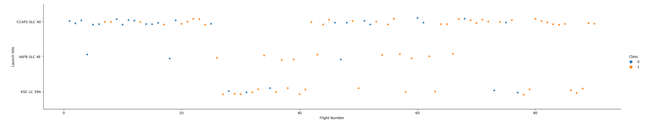
Flight Number vs. Launch Site
As shown in the scatterplot below, the success rate of each launch site increases as the flight number increases, indicating a strong correlation that can be used in modeling. This can be attributed to the refining of the landing technology over time with each successive attempt. That said, KSC LC-39A has the highest success rate for all launches at that location.

Slide 22
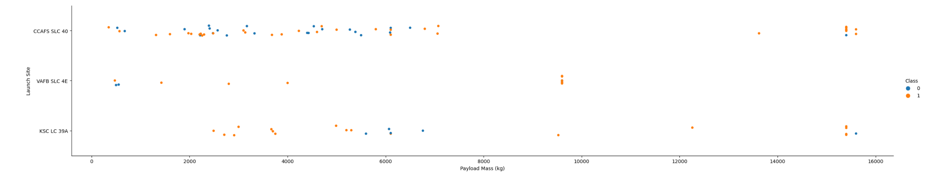
Payload vs. Launch Site
As seen in the graph, VAFB SLC-4E has not been used for any payloads greater than 10,000kg. CCAFS SLC

Slide 23
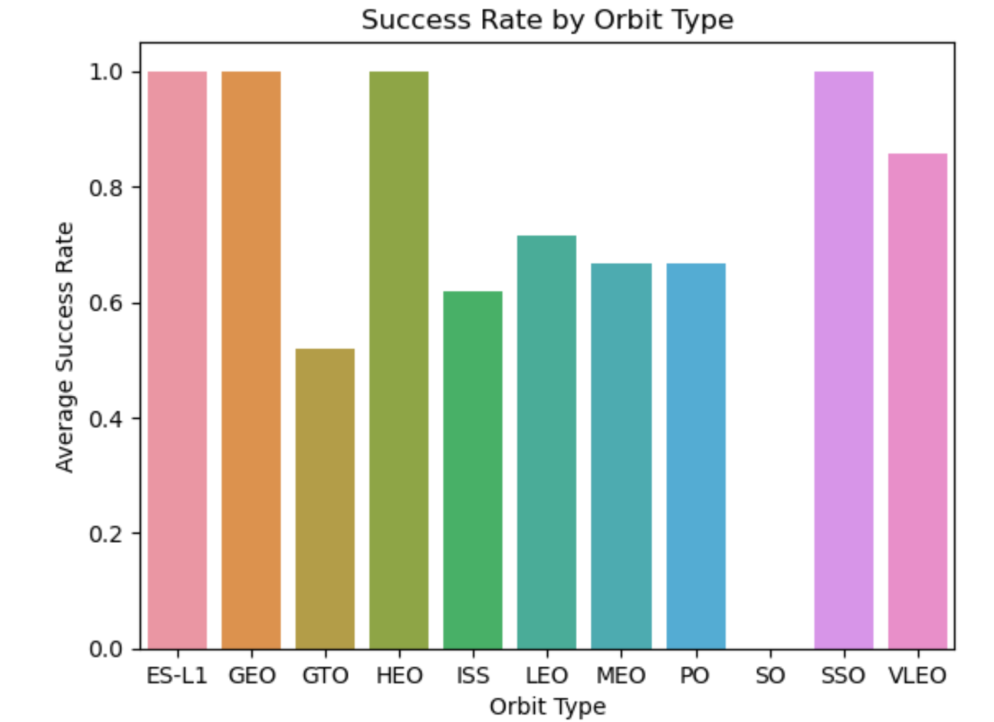
Success Rate vs. Orbit Type
As seen, launches to different orbits have different success rates. The orbits with the highest rates of success are ES-L1, GEO, HEO, and SSO with nearly 100% average success rate. By contrast, the least successful orbit to launch to has been GTO, with an average success rate of about 50%.

Slide 24
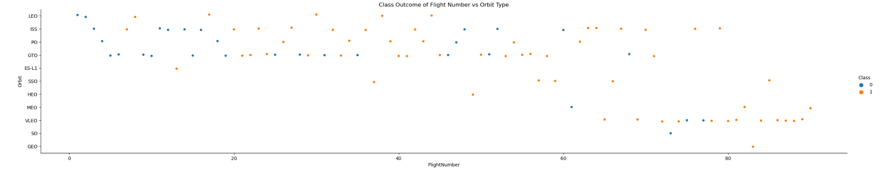
Flight Number vs. Orbit Type
As seen in the scatterplot below, orbits such as GEO, SO, VLEO, and MEO were not used for early launches. Rather, the predominant orbits of early launches were GTO and ISS. The data shows a mix of successful and failed launches for each orbit type, even in later flight numbers, which does not indicate any strong correlation emerging in this comparison.

Slide 25
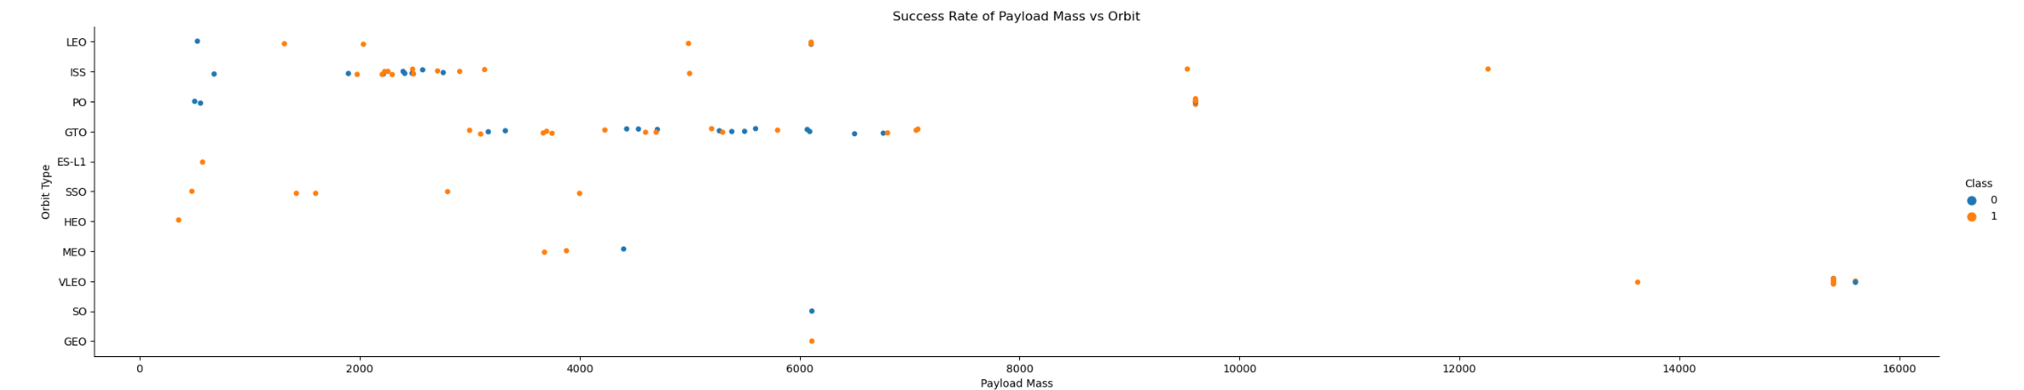
Payload vs. Orbit Type
Here we see that the success rate with heavy payloads is greater for Polar, LEO, and ISS orbits. However, with a GTO orbit the data is a mix of positive and negative outcomes, showing that payload mass is not universally correlated with orbit type.

Slide 26
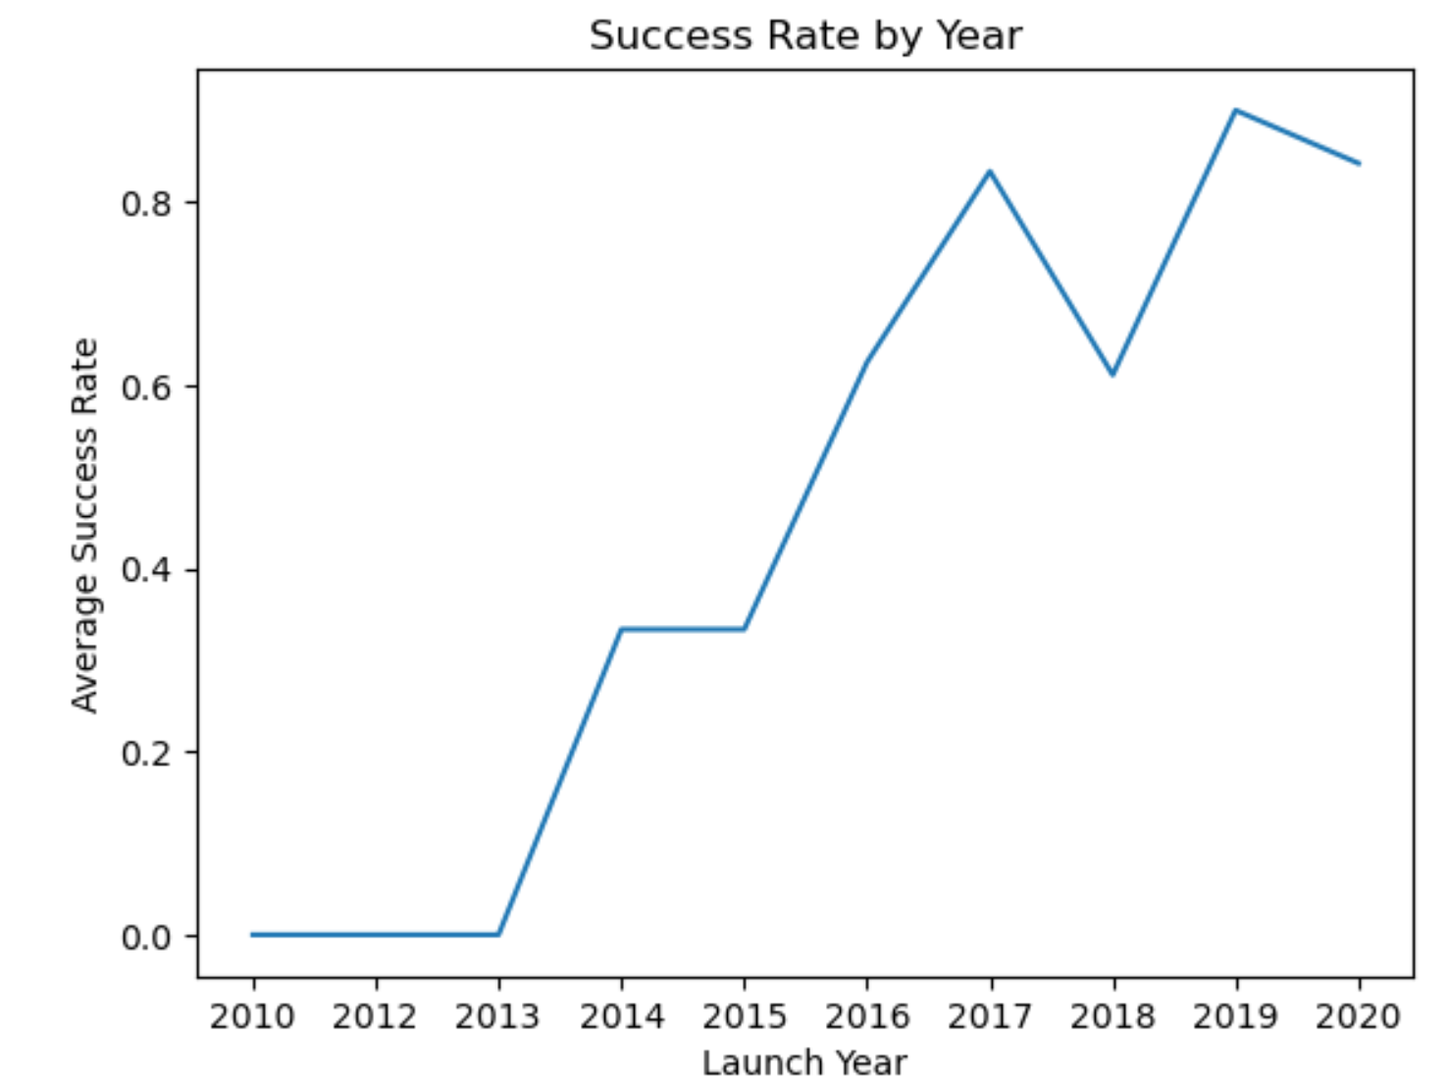
Launch Success Yearly Trend
Here we see that the calculated average yearly success rate increases over time. We noticed this trend in earlier analyses, now we can plot it directly. Therefore, the launch year and the average success rate have a clear positive correlation.

Slide 27
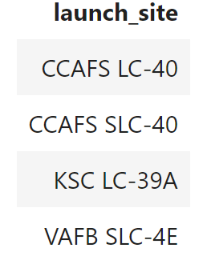
All Launch Site Names
Using the following SQL query, we were able to find the names of all launch sites:
select distinct(LAUNCH_SITE) from CAPSTONE.SPACEX;
This returns the following list of distinct launch site names:

Slide 28
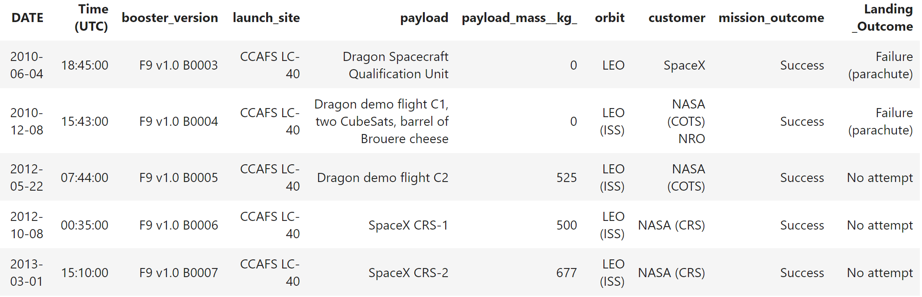
Launch Site Names Begin with 'CCA'
Using the above launch site names, we are able to query the database to filter for records where the launch site name includes ‘CCA’ (which will return values for CCAFS LC and SLC).

Slide 29
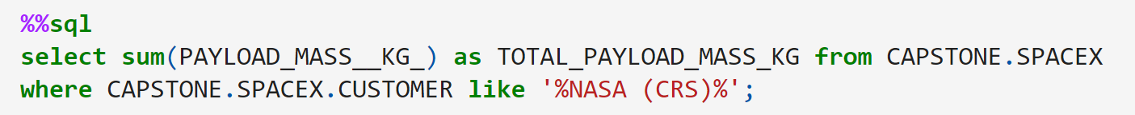
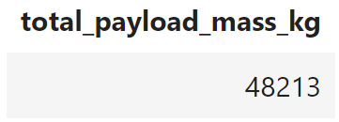
Total Payload Mass
In order to find the total payload mass carried by NASA, for example, we can use the following query:
This returns the following calculated value, which represent the total cumulative payload mass (in kg) launched by NASA:

Slide 30
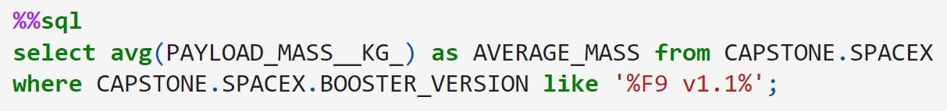
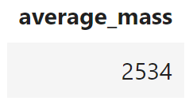
Average Payload Mass by F9 v1.1
To calculate the average payload mass carried by the Falcon 9 v1.1, we use the following SQL query:
This filters the database for records where the booster version includes the label F9 v1.1, and averages the payload mass of those records to return the following value:

Slide 31

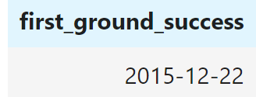
First Successful Ground Landing Date
Next, we want to find the first occurrence of a successful ground landing. We use the following query to filter the data records for entries where the landing outcome is ‘Success (ground pad)’, then use a “min” function on the date column to find the first instance:
This returns the following date:

Slide 32
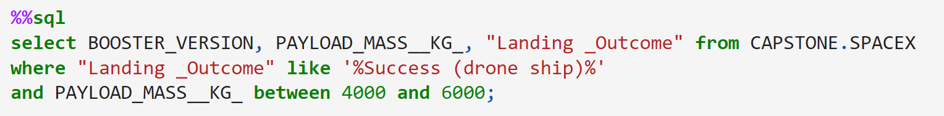
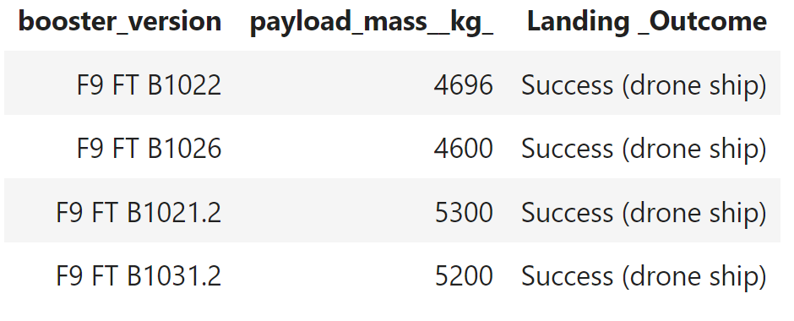
Successful Drone Ship Landing with Payload between 4000 and 6000
Now we want to find the names of the booster versions that have successfully launched payloads between 4000 and 6000 kilograms. We use the following query to filter the data for results matching our criteria:
This returns the following list of booster versions:

Slide 33
Total Number of Successful and Failure Mission Outcomes
Calculate the total number of successful and failure mission outcomes
Present your query result with a short explanation here

Slide 34
Boosters Carried Maximum Payload
List the names of the booster which have carried the maximum payload mass
Present your query result with a short explanation here

Slide 35
2015 Launch Records
List the failed landing_outcomes in drone ship, their booster versions, and launch site names for in year 2015
Present your query result with a short explanation here

Slide 36
Rank Landing Outcomes Between 2010-06-04 and 2017-03-20
Rank the count of landing outcomes (such as Failure (drone ship) or Success (ground pad)) between the date 2010-06-04 and 2017-03-20, in descending order
Present your query result with a short explanation here

Slide 37

Section 3

Slide 38
<Folium Map Screenshot 1>
Replace <Folium map screenshot 1> title with an appropriate title
Explore the generated folium map and make a proper screenshot to include all launch sites’ location markers on a global map
Explain the important elements and findings on the screenshot

Slide 39
<Folium Map Screenshot 2>
Replace <Folium map screenshot 2> title with an appropriate title
Explore the folium map and make a proper screenshot to show the color-labeled launch outcomes on the map
Explain the important elements and findings on the screenshot

Slide 40
<Folium Map Screenshot 3>
Replace <Folium map screenshot 3> title with an appropriate title
Explore the generated folium map and show the screenshot of a selected launch site to its proximities such as railway, highway, coastline, with distance calculated and displayed
Explain the important elements and findings on the screenshot

Slide 41

Section 4

Slide 42
<Dashboard Screenshot 1>
Replace <Dashboard screenshot 1> title with an appropriate title
Show the screenshot of launch success count for all sites, in a piechart
Explain the important elements and findings on the screenshot

Slide 43
<Dashboard Screenshot 2>
Replace <Dashboard screenshot 2> title with an appropriate title
Show the screenshot of the piechart for the launch site with highest launch success ratio
Explain the important elements and findings on the screenshot

Slide 44
<Dashboard Screenshot 3>
Replace <Dashboard screenshot 3> title with an appropriate title
Show screenshots of Payload vs. Launch Outcome scatter plot for all sites, with different payload selected in the range slider
Explain the important elements and findings on the screenshot, such as which payload range or booster version have the largest success rate, etc.

Slide 45

Section 5

Slide 46
Classification Accuracy
Visualize the built model accuracy for all built classification models, in a bar chart
Find which model has the highest classification accuracy

Slide 47
Confusion Matrix
Show the confusion matrix of the best performing model with an explanation

Slide 48
Conclusions
Point 1
Point 2
Point 3
Point 4
…

Slide 49
Appendix
Include any relevant assets like Python code snippets, SQL queries, charts, Notebook outputs, or data sets that you may have created during this project

Slide 50


